Slide 1
10-1 The Formal Elements of Games
5CM503 Virtual Environment Development
Dr Patrick Merritt

Slide 2
Contents
What is a game?
The formal elements of games.

Slide 3
Formal elements of games
What makes a game a game?

Slide 4
What is a game?

Slide 5
What is a game?
It is something you play
Something = It has been created or designed.
You = It involves people or players
Play = What is Play?

Slide 6
What is play?

Slide 7
What is play?
Play is the exercise of our physical & mental capacities in a constrained, low-risk environment.

Slide 8
What is play?
Play is the exercise of our physical & mental capacities in a constrained, low-risk environment.
To play is to learn to get better at something.
(In an environment of reduced stress)
Play must be low risk.
(War is high risk, chess is low risk)
Play must be constrained.
(Rules for what is and is not part of the game)
Play must provide feedback.
(Otherwise no learning is possible)

Slide 9
Why Play
Evolution has wired us to enjoy playing.
We work to master skills.
We learn a skill in a safe environment before needing it in a high-stakes one.

Slide 10
Are Play and Games different?

Slide 11
What is a game?
“A game is a system in which players engage in an
artificial conflict defined by rules that results in a
quantifiable outcome”
(Salen & Zimmerman, 2004)
Basically a Game has more structure and a clearly defined goals than play.
This is not to say we do not play or we are no longer challenged but we enter a state of play which have formal constraints applied to player, an understood way to play and strategies to create an uneven outcome (win or lose).

Slide 12
Think about these descriptors…
Players are active.
They make decisions.
They are invested.
Potential winners.
They are a very distinct subset of people.
Do these set of comparisons relate to a Card game or an FPS?

Slide 13
What are the formal elements of games?
Boundaries
Rules
Procedures
Resources
Objectives
Conflict
Outcome

Slide 14
Boundaries
This can be physical (court, level) or conceptual (time, agreed rules) but it is the space in which we can play the game, and it is the space that everything exists in.
Once we enter we are constrained by the boundaries of the game.
When we leave they do not apply.

Slide 15
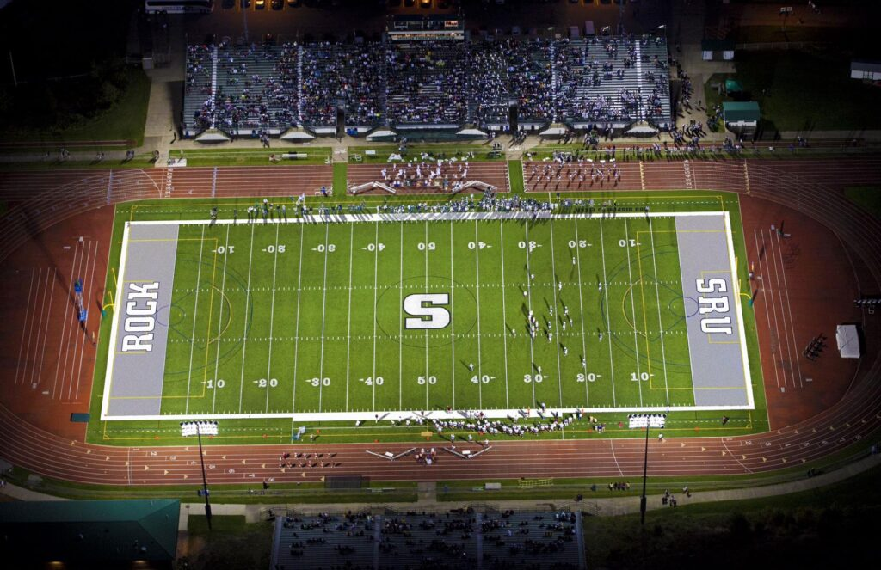

Slide 16
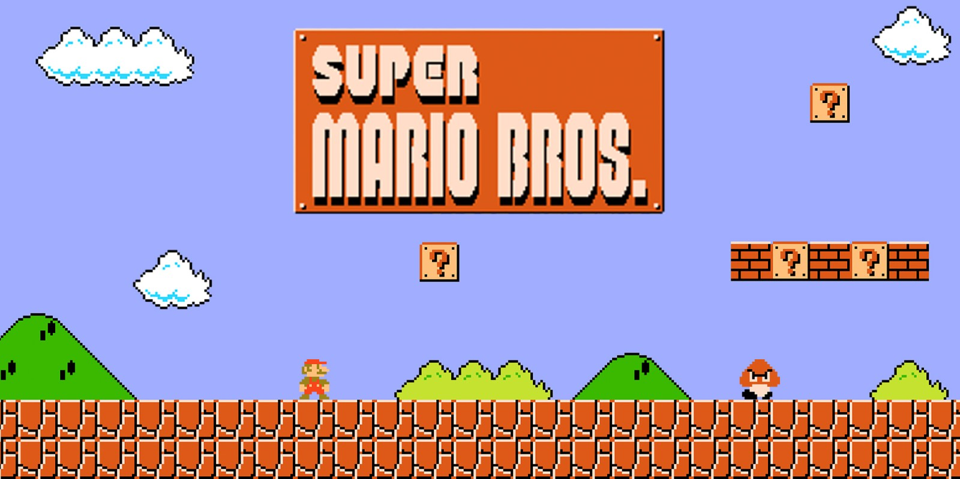

Slide 17
Rules
Rules define what can and can’t be done in the game space. Rules define game objects, prescribe principles, and limit behaviour within the game.
These rules are respected because the players understand that they are a key structural element of the game, and without them, the game would not function.

Slide 18
Rules examples
You must deal out 5 cards to each player face down.
Grenade Launcher use Grenade Launcher ammo.
TF2 character select and weapons before the game starts.

Slide 19
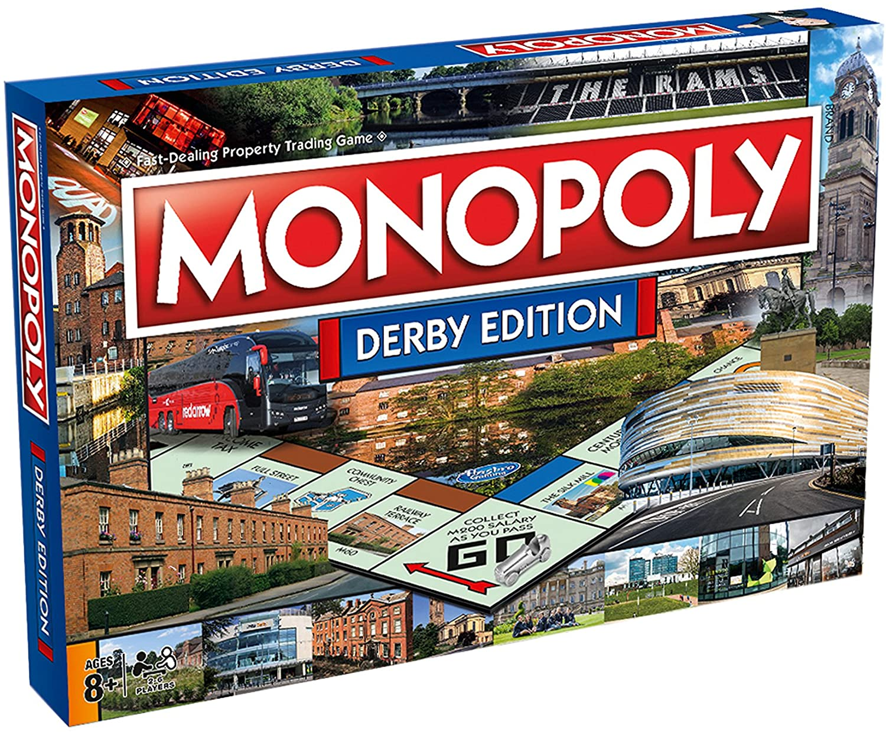
https://www.ultraboardgames.com/monopoly/game-rules.php

Slide 20
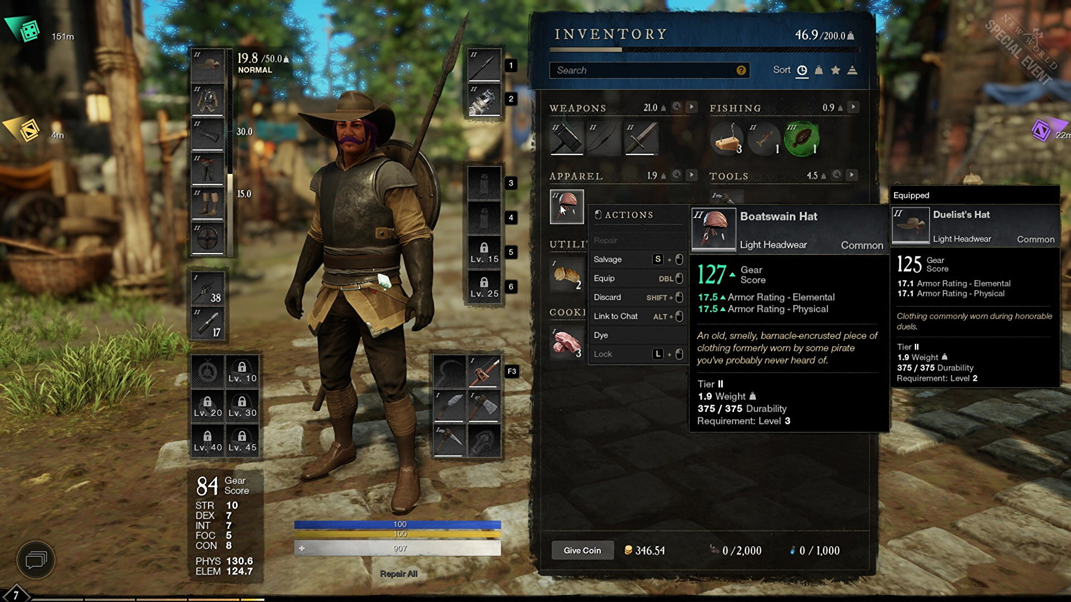

Slide 21
Procedures
These are the actions or methods of play allowed by the rules, are an important distinction of the experiences we call games.
They guide player behaviour, creating interactions which would probably never take place outside the authority of the game

Slide 22
Procedure examples
The player can run forward, backwards.
The player can kick the ball.
In Skyrim you can upgrade your weapon on the grindstone at a forge.

Slide 23
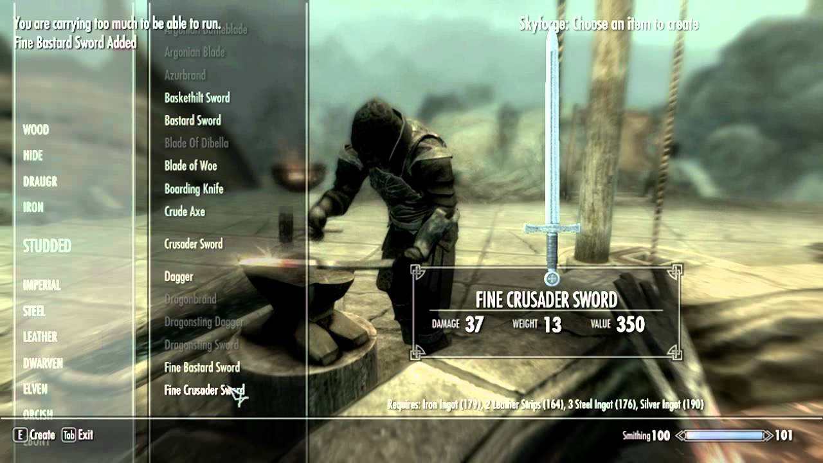

Slide 24
Objectives
The objective is a key element that determines the structure of the game and how we play it. Our need to work towards the objective is a measure of our involvement and progress in the game.

Slide 25
Objective examples…
Capture the Flag.
When you are the last person alive you win.
Kill the oppositions general.

Slide 26
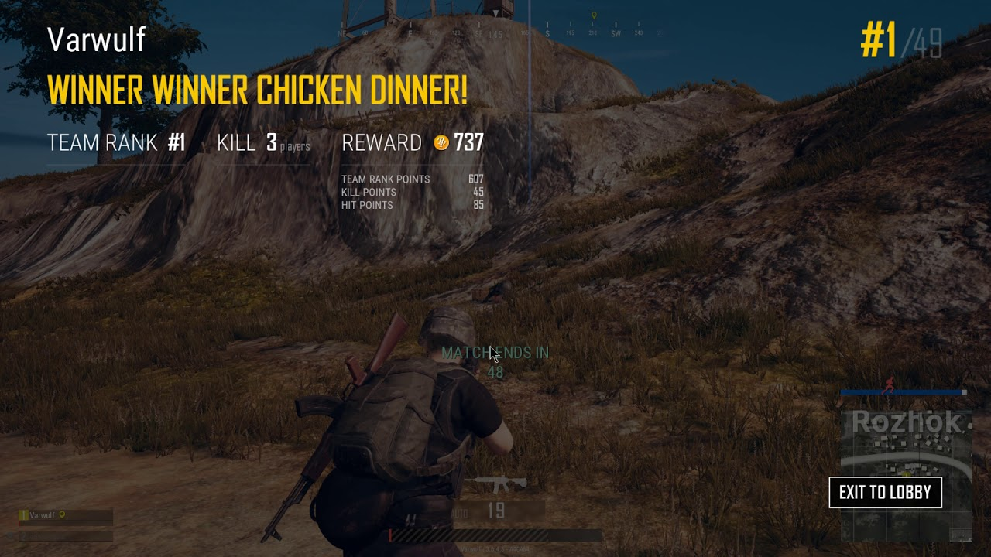

Slide 27
Resources
Items made valuable by their rarity and utility. In the real world, and in game worlds, resources can be used to further our aims; they can be combined to make new products or items; and they can be bought and sold in various types of markets.

Slide 28
Resource examples…
Chess pieces.
Mana.
Cards.

Slide 29
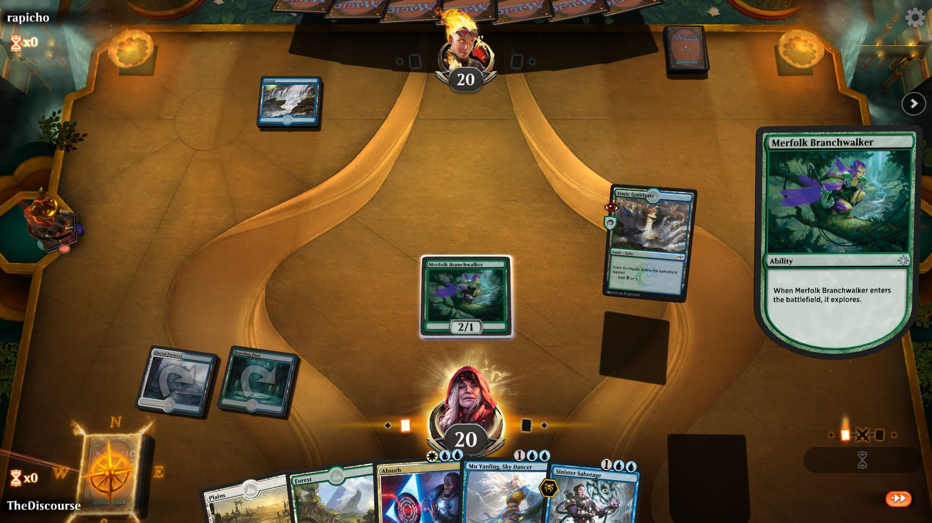

Slide 30
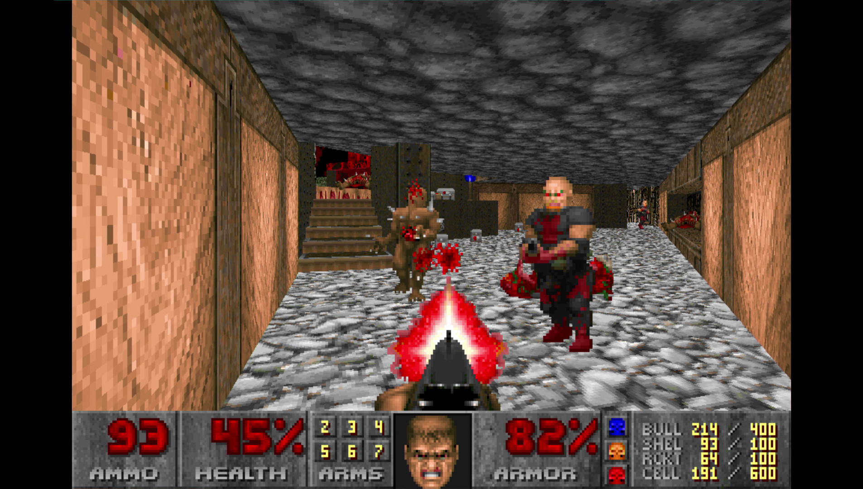

Slide 31
Conflict
The problem for the players is that the procedures and rules of games tend to deter them from accomplishing goals directly this allows for all kinds of interesting ways to try and win the game, through risk, strategy and chance.

Slide 32
Conflict examples…
“I need a Jack to win however as I can’t see anyone else hand who has it?”
MGS Shadow Moses…
I lose DPS if I move out of the fire…

Slide 33
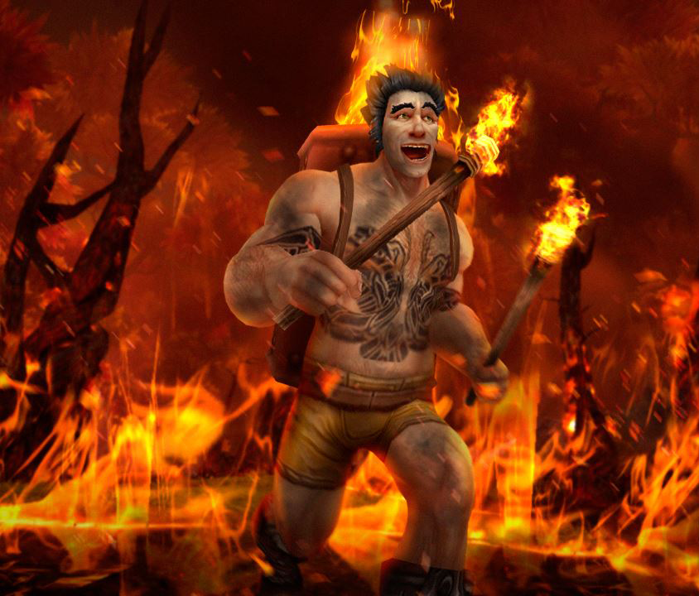

Slide 34
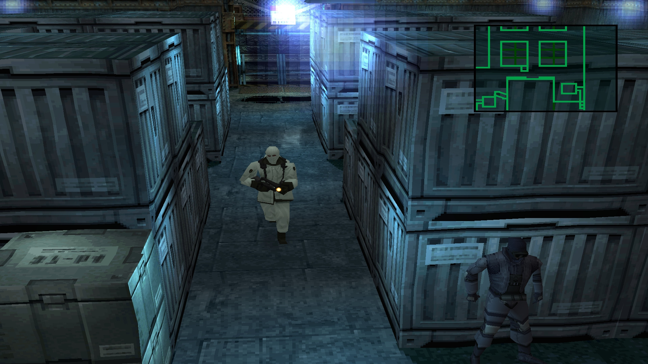

Slide 35
Outcome
Driving towards measurable and unequal outcomes (winner and loser).
The outcome differs from the objective in that all players may achieve the objective, but other factors within the system may determine which of these actually win the game

Slide 36
Outcome Examples…
Collect the highest score from the predefined number of rounds.
Capture the flag the most in the predefined time limit.
Kill the enemy general, before they kill yours.

Slide 37
